Slide 1
CSC 355 Database Systems
Lecture 9
Eric J. Schwabe
School of Computing, DePaul University
Spring 2020

Slide 2
Today:
Transactions

Slide 3
Problem: Interruptions
Two SQL statements are written to transfer money from one bank account to another…
…one executes, then the server crashes
  What happens to the money?

Slide 4
Problem: Concurrency
Two users check the balance of the same bank account…
…then both try to transfer money out of it
  Who gets it?

Slide 5
Solution: Transactions
A transaction is a collection of SQL statements that must be executed as a unit
The Transaction manager in the DBMS must handle
  Interruptions: Logging and recovery, Buffers
  Concurrency: Concurrency control, Lock tables

Slide 6
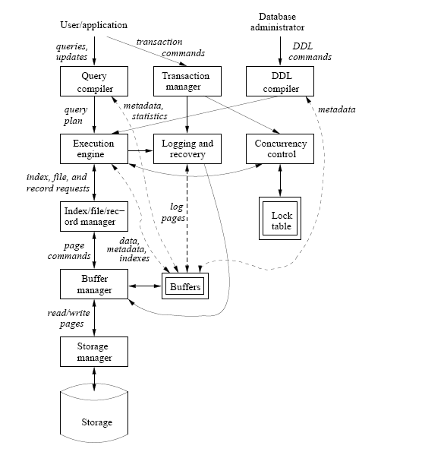
Components of a DBMS
(From Ullman/Widom)

Slide 7
Transactions in Oracle
Any operation that changes the database state starts an implicit transaction in Oracle
Can also start a transaction explicitly with a SET TRANSACTION statement
End a transaction with a COMMIT statement
  Transaction can also be ended with ROLLBACK, usually done by system rather than user…

Slide 8
ACID Properties
A transaction should satisfy the following properties:
  Atomicity: Executes completely or not at all
  Consistency: Satisfies all database constraints
  Isolation: Executes “separately” from others
  Durability: Once executed, results are permanent

Slide 9
Atomicity
Transaction operations are kept in a local store, not applied to the database immediately
  Transaction can see its own changes, others can’t
When a transaction is completed, COMMIT applies changes to the shared database in their entirety (“executes completely…”)
ROLLBACK during a transaction undoes any partial results (“…or not at all”)

Slide 10
Durability
After COMMIT, the changes applied to the shared database are permanent, and cannot be rolled back later

Slide 11
Consistency
Constraints can be “deferred”, so that they are only checked when a transaction commits, not for each individual statement
  Add DEFERRABLE INITIALLY DEFERRED to the constraint definition
  If a constraint is violated when you COMMIT, a ROLLBACK of the entire transaction is done!

Slide 12
Isolation
DBMS maintains “separation” among transactions that access data concurrently
  Various different levels of isolation
    Transactions might modify, or just read, data
  Tradeoff between performance and data integrity

Slide 13
Serializable Isolation
Transactions must behave as though they were run serially (first one, then the other)
Usually implemented by “locking” the tables (or parts of tables) used by a transaction
  Other transactions using the same tables will have to wait until they are released
  Other transactions using other tables could run at the same time

Slide 14
Read Committed Isolation
Transaction operations can be interleaved
If one transaction tries to read data that were written by another, it can only see the changes that have been committed
  Can’t be rolled back, but could be changed later
  Multiple queries of the same table might not yield the same results... “non-repeatable reads”, including “phantoms”…

Slide 15
Read Uncommitted Isolation
Transaction operations can be interleaved
If one transaction tries to read data that were written by another, it can see all changes, even if they have not been committed
  Could be rolled back by the other transaction!
  Transaction might make decisions based on values that are later rolled back and so were never really there … “dirty reads”…

Slide 16
Isolation Levels
SERIALIZABLE: Transactions must appear to run serially – cannot read any changes from others
[REPEATABLE READ: Can read committed changes that only add data (allows only phantoms)]
READ COMMITTED: Can read all committed changes (allows all non-repeatable reads)
READ UNCOMMITTED: Can read all changes (allows all non-repeatable reads and dirty reads)

Slide 17
Transactions in Oracle
SET TRANSACTION statement can specifiy ISOLATION LEVEL
  READ COMMITTED (default)
  SERIALIZABLE
  Oracle does not support REPEATABLE READ and READ UNCOMMITTED
COMMIT or ROLLBACK ends transaction

Slide 18
Next:
Finish Transactions
Review for Midterm Exam
Introduction to Relational Database Design

